Slide 1
WELCOME

Slide 2
Weapon Detection using Artificial Intelligence and Deep Learning for Security Applications Levels
Group Membersname :Ajay Das K, Muhammed Safeer T,
Najmudheen Kp,fathima C
Register Number: CCV19CS002, CCV19CS016, CCV19CS018,
CCV19CS006
Class : S6 CSE
Area of seminar: Ai Vision
Guide name : Mrs. Sruthy Das
Assistant Professor (CSE Dept)
MGM College of Engineering
Date Of Submission :24/05/2022

Slide 3
TABLE OF CONTENTS
01
02
03
04
INTRODUCTION
LITERATURE SURVEY
PROPOSED SYSTEM
SYSTEM REQUIREMENTS
05
06
REFERENCE
EXPECTED
OUTCOME

Slide 4
01. INTRODUCTION
Deep learning- based approach is used to solve the problem of object detection in an end-to-end fashion.
Incorporate state-of-the-art technique for detecting the object placed in front of the webcam with the goal of achieving high accuracy with a real-time performance using deep learning
Based on the detected image several preprogrammed robots are used to transport the object in the detected image from the place where humans cannot work flawlessly to the desired location efficiently.
Deep learning and robotics which can be used in militry and also use several areas such as mines, construction sites, steel factories etc where human works in a risky environment.

Slide 5
02. LITERATURE SURVEY
TOPIC | PUBLICATION YEAR | FEATURES | PROS | CONS
Automation using Machine Learning and Object Detection | NTASU - 2020 Conference Proceedings | Machine Learning, object detection, Single shot detection, automation, robotics. | which can be used ,where human works in a risky environment | Chances of lost connectivity
Development of Tools and Strategies for Rover Vehicle Design | Vol. 7 Issue 02, February-2018 | Rover Design, Genetic Algorithm, Rover System Modelling, Computational Tool Development | For designing to suitable user defined objectives, these models when integrated with Genetic Algorithm form an effective tool to support rapid design trade-offs during conceptual design process. This integrated modeling and optimization approach is thought to be efficient in identifying rover system concepts. For demonstrating the tool’s application, different design criteria based on user requirements are considered. | Some observations can be made of the design solution obtained after the optimization procedure.

Slide 6
02. LITERATURE SURVEY
TOPIC | PUBLICATION YEAR | FEATURES | PROS | CONS
High Efficiency All Terrain Exploratory Rover | NCETET-2015 Conference Proceedings | i. Gain information about the environment [5]. ii. Work for an extended period without human intervention [2]. iii. Move either all or part of itself throughout its operating environment without human assistance [3]. iv. Avoid situations that are harmful to people, property, or itself unless those are part of its design specifications. | The communication between the rover and the base station occur wirelessly | Chances of lost connectivity
Surveillance Rover for Scientific Applications | Proceedings of International Conference “ICSEM’13”2013 | Astable multivibrator, Pick-up coil, Distant monitoring facility, Poor accessible areas | Advancement in technology has provided different sensors for constantly monitoring the said parameters. This rover is self powered with a rechargeable battery and it moves on wheels. It can work continuously for hours with this in-built battery | Chances of lost connectivity

Slide 7
02. LITERATURE SURVEY
TOPIC | PUBLICATION YEAR | FEATURES | PROS | CONS
Visual Object Detection and Tracking using YOLO and SORT | Vol. 8 Issue 11, November-2019 | Tracking-by-detection, You Only Look Once (YOLO), Simple Online and Realtime Tracking (SORT), visual tracking. | An algorithm analyses sequential video frames and outputs target motion between frames to execute video tracking. Various algorithms exist, each with strengths and weaknesses. | variations in illumination, changes in scale, rapid and abrupt movement, partial occlusions, movement blur, deformation of objects and background clutters.
Object Detection and Classification using YOLOv3 | NCREIS - 2020 | YOLO, Convolutional Neural Network, Bounding Box, Anchor Box, Fast Region Based Convolutional Neural Network, Intersection over Union, Non-Max Suppression, COCO Datase | Fast Region Based Convolutional Neural Network, Intersection over Union, Non-Max Suppression, | The rules are easy to create and can be instantly comprehensively photographed
Multiple Object Tracking using Deep Learning with YOLO V5 | NCREIS - 2021 Conference ProceedingsConference Proceedings | Multiple Object Tracking (MOT); YoloV5; Deep Learning; Dataset/Model | Tracking can broadly be divided into multiple Object Tracking (MOT) and single object tracking. Multiple Object Tracking (MOT) p | While the custom model was used the object detection and tracking had an accuracy prediction in range of 20-90% according to the clarity of image and appearance of object in image.

Slide 8
03. PROPOSED SYSTEM
Contain a moving terestrial drone
The drone contain
Powe unit
Motor& wheels.
Motor controling unit
Recever and transmitter
Cameras & sensors
Cpu system
Tracking device
The drone is controlled wireless and automatic modes
Can be used places where human works in a risky environment
Ecnomical than human
Also used as weapon.

Slide 9
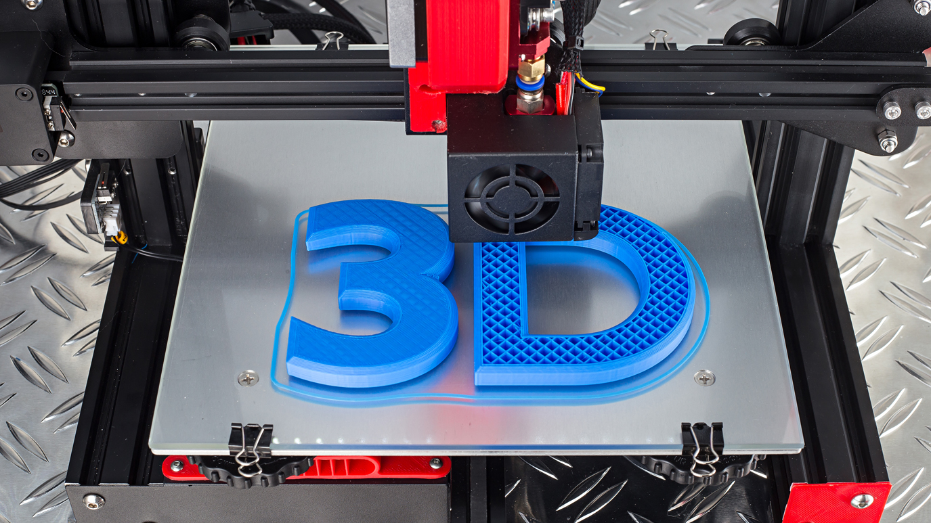
3D printing, or additive manufacturing, is the construction of a three-dimensional object from a CAD model or a digital 3D model.

Slide 10
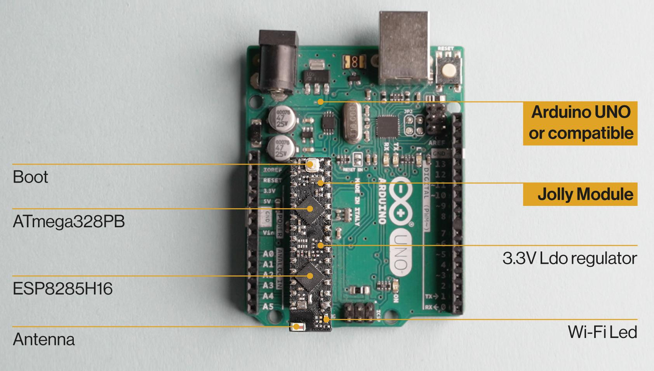
Arduino microcontroller Featured snippet from the web Arduino consists of both a physical programmable circuit board (often referred to as a microcontroller) and a piece of software, or IDE (Integrated Development Environment) that runs on your computer, used to write and upload computer code to the physical board.

Slide 11
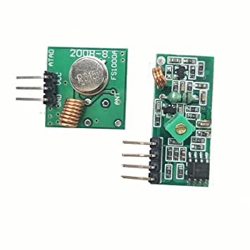
RF Transmitter Receiver Module By combining the two objects i.e. wireless communication with Arduino, we can create a wide range of applications like remote controlled cars, wirelessly operated robots, home automation, simple data transfer etc. In this project, we are going to design a system in which two Arduino boards will communicate with each other using RF Module.

Slide 12
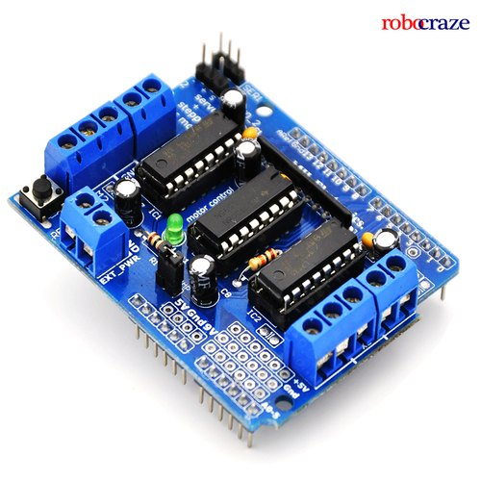
Motor drivers we can control the speed of the DC motor by simply controlling the input voltage to the motor and the most common method of doing that is by using PWM signal.

Slide 13
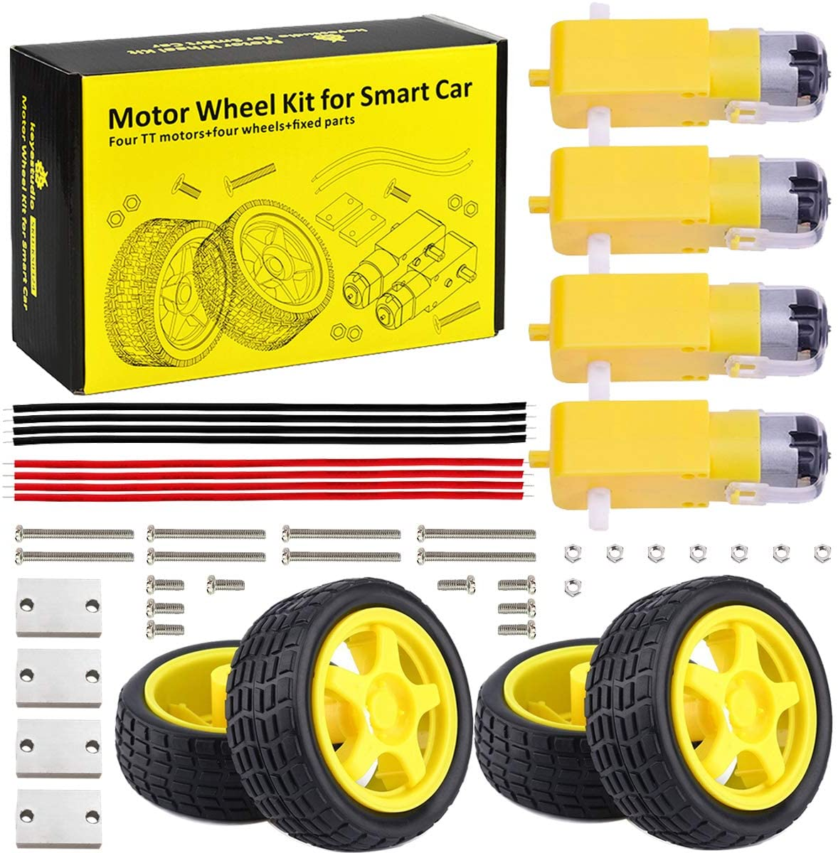
Motor and wheels.

Slide 14
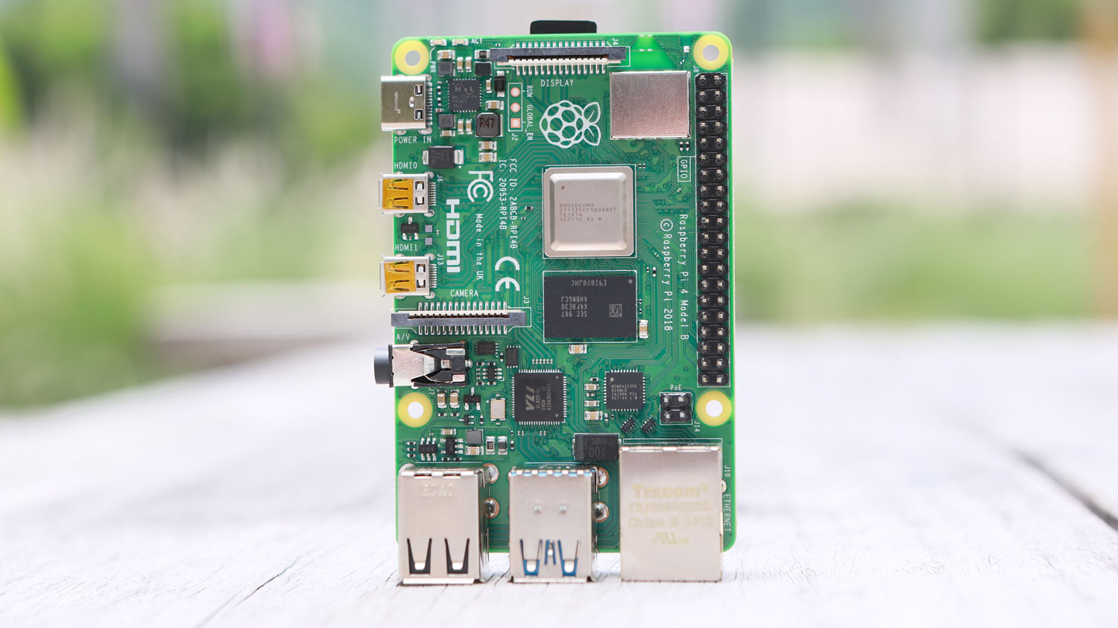
people use the Raspberry Pi to learn programming skills, build hardware projects, do home automation, implement Kubernetes clusters and Edge computing, and even use them in industrial applications.

Slide 15
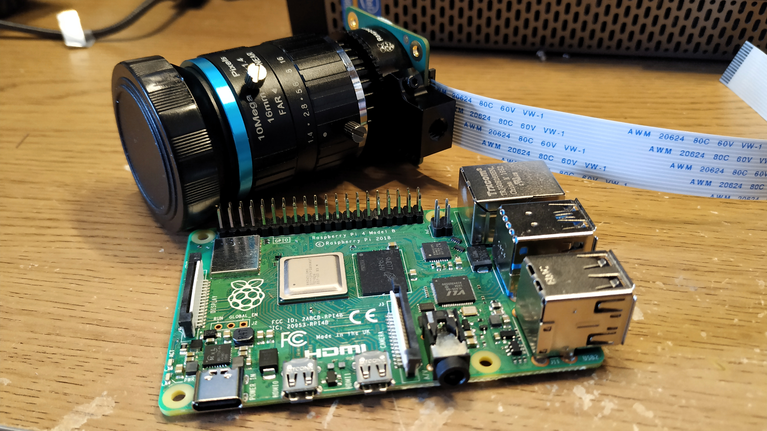
The Camera Module can be used to take high-definition video, as well as stills photographs.

Slide 16
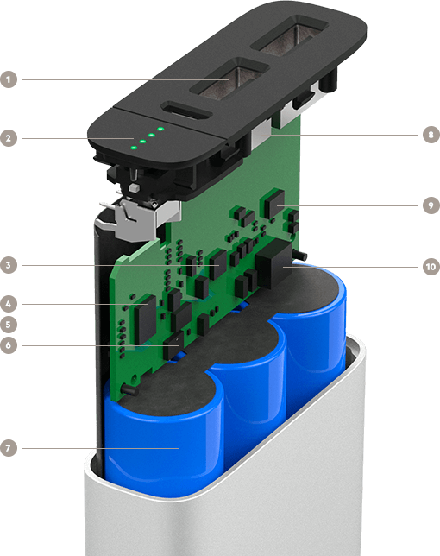
battary power unit

Slide 17
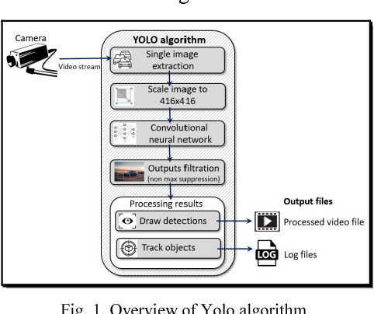
YOLO algorithm employs convolutional neural networks (CNN) to detect objects in real-time. As the name suggests, the algorithm requires only a single forward propagation through a neural network to detect objects. This means that prediction in the entire image is done in a single algorithm run

Slide 18
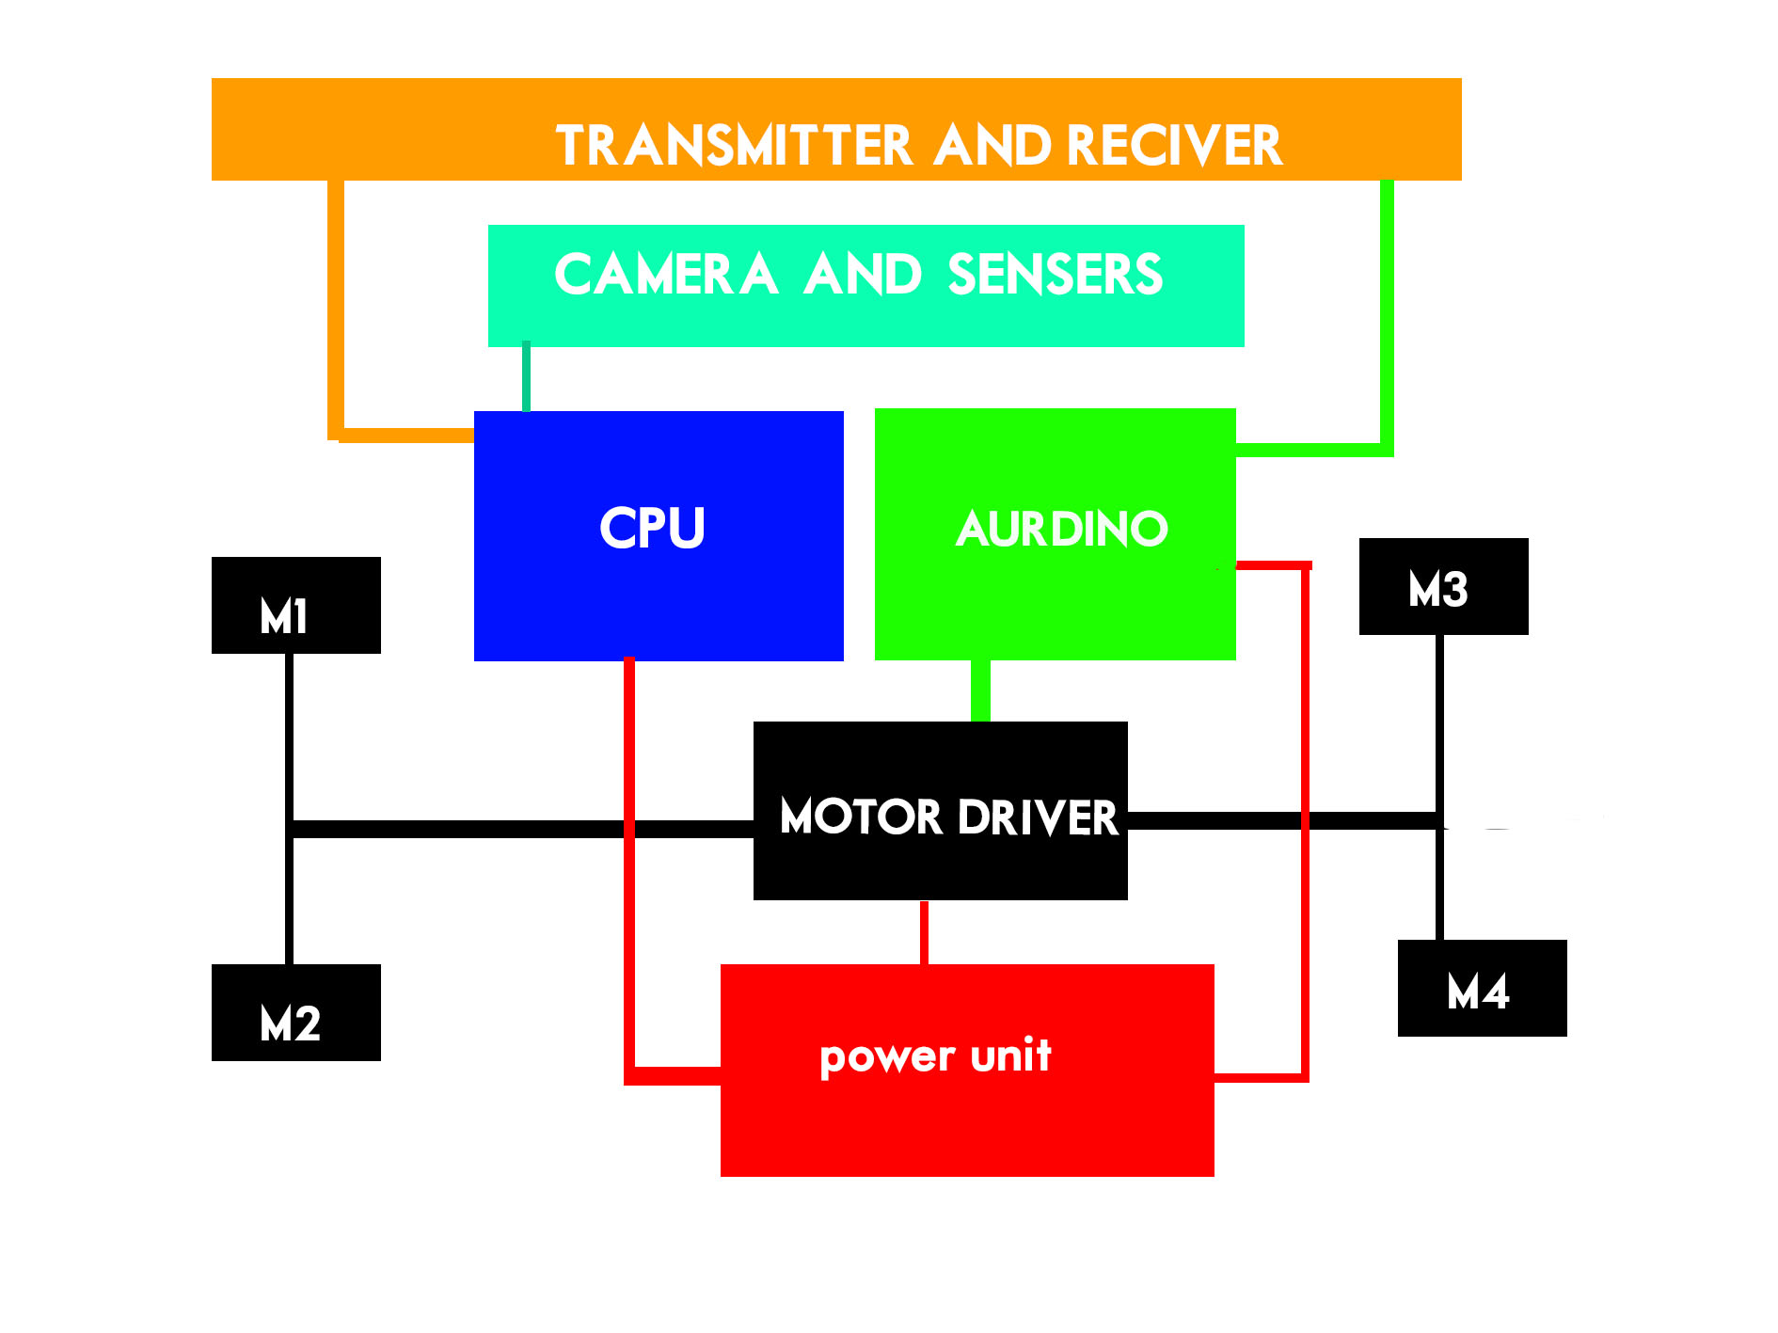
SCHEMATIC

Slide 19
04.SYSTEM CONFIGURATION
WINDOWS 7+ / UBANDU OPERATING SYSTEM
AURDINO UNO OR +
LM32 MOTOR DRIVER
BRUSH MOTORS
BLUETHOOTH OR WIFI RADIO TRANSMITTERS
RASBERRY PI 4B
CAMERA MODULE AND SENSERS
LANGUAGE C,PHYTHON
EXTERNAL MODULE_YOLO ALGORITHM
3D PRINTED PARTS
SMARTPHONE FOR TRANSMITER
POWER UNIT 5V- 9V

Slide 20
05.EXPECTED OUTCOME
A MINI ALL TERESTRIAL ROVER DRONE
THE DRONE CAN BE CONTROLLED MANUALY OR AUTOMATIC MODES
THE DRONE CAN DEDUCT OBJECT SUCH AS WEPONS AND OTHER OBJECTS.
WE CAN OBSERVE ANY THING AND MAKE PROGRESSIONS WITHOUT HUMAN HANDS .

Slide 21
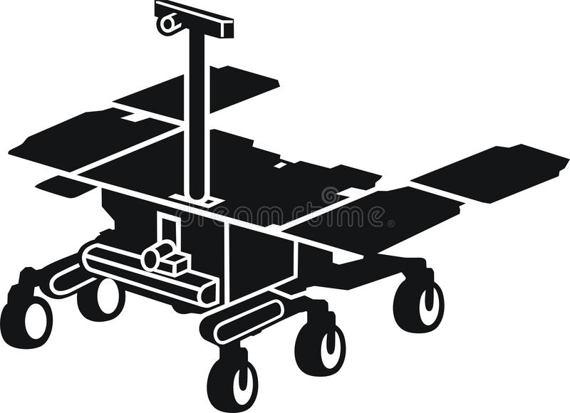
EXPECTED OUTCOME

Slide 22
06.REFERENCES
Authors : Akshaykumar Pillai, Akash Dhayalkar, Meghan Yesji, Trupti Shah
Paper ID : IJERTCONV9IS03047
Volume & Issue : NTASU – 2020 (Volume 09 – Issue 03)
Wikipedia
GitHub:
Stack Overflow
[1] Li Tan, Xu Dong, Yuxi Ma, Chongchong Yu ,“ A Multiple Object Tracking Algorithm Based on YOLO Detection” ,IEEE, 2018 [2] ShiJie Sun, Naveed Akhtar, HuanSheng Song, Ajmal Mian, Mubarak Shah ,” Deep Affinity Network for Multiple Object Tracking ”, JOURNAL OF LATEX CLASS FILES, VOL. 13, NO. 9, SEPTEMBER 2017. [3] HASITH KARUNASEKERA , HAN WANG , (Senior Member, IEEE), AND HANDUO ZHANG “ Multiple Object Tracking With Attention to Appearance, Structure, Motion and Size”,IEEE, 104423-104432 ,VOLUME 7, 2019 [4] Shriharsha S. Veni,Ananda S. Hiremath,Mahalakshmi Patil, Mayuri Shinde, Aishwarya Teli “ Video-Based Detection, Counting and Classification of Vehicles using OpenCV ” ICICNIS 2020. [5] Samira Karimi Mansoub,Rahem Abri,Anıl Hakan Yarıcı,” Concurrent Real-Time Object Detection on Multiple Live Streams Using Optimization CPU and GPU Resources in YOLOv3 ” , IARIA, 2019, ISBN: 978-1-61208-716-0.

Slide 23
THANK YOU
Do you have any questions?

